Slide 1
Investor’s Dream
Fintech - Project 1
Group 2 Collaborators:
Julian Ritchey
John Yin
Andrea Delgadillo Tomasevich
Dmitry Chalganov
Presentation Date: April 19, 2023

Slide 2

Purpose of the Project
Create an easy way for investors to Create and Analyze portfolios
Track Historical and Current Investments in real time

Slide 3

Important Questions
How can an investor compare multiple simulated portfolios to determine their ideal investment portfolio?
How can an investor make the most money with the least amount of risk?
Which asset mix can provide the strongest portfolio given current market conditions?
In what ways can an investor visualize their investment planning data?
Who could use this application?

Slide 4
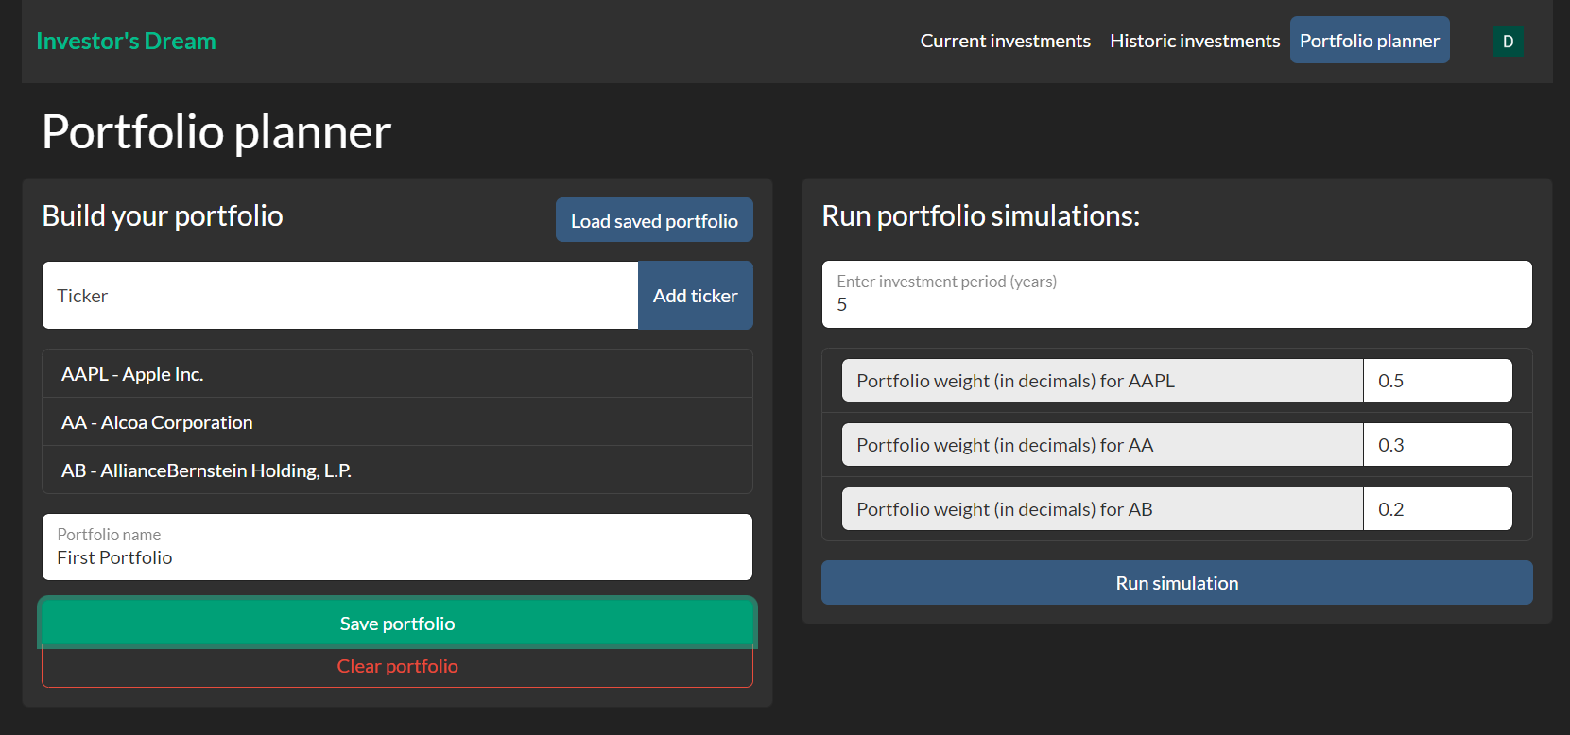
How can an investor compare multiple simulated portfolios to determine their ideal investment portfolio?
With Investor’s Dream it is possible to add multiple portfolios, save them in a database and run the simulation for each portfolio individually

Slide 5
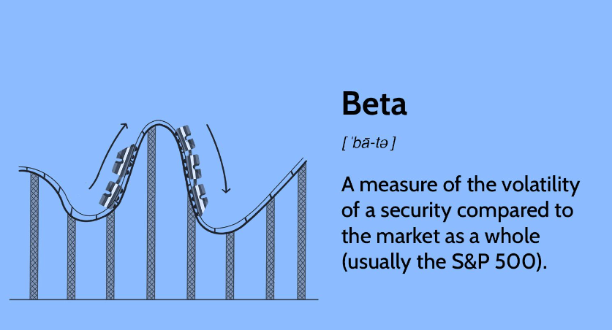
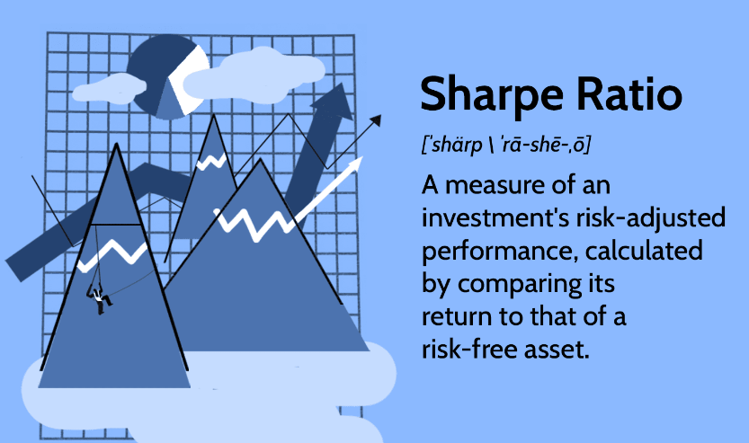
How can an investor make the most money with the least amount of risk?
Investor’s Dream can:
Calculate Daily Returns
Calculate Cumulative Returns
Calculate Beta
Calculate Sharpe Ratio
Run Monte Carlo Simulation
Visualize Graphics

Slide 6
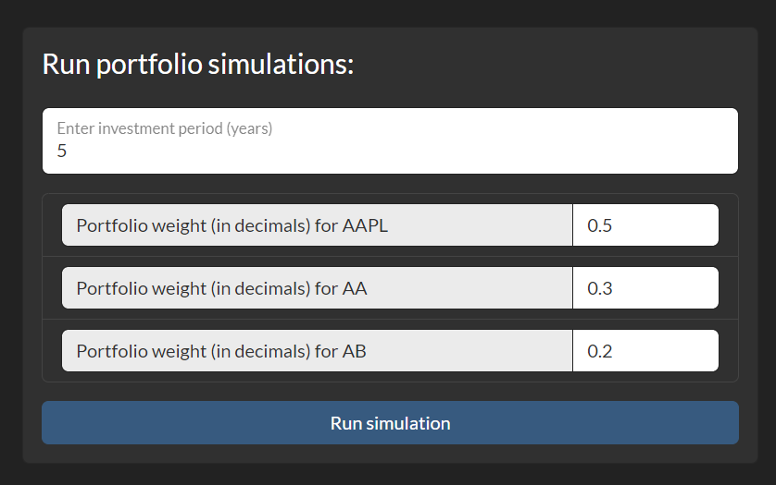
Which asset mix can provide the strongest portfolio given current market conditions?

Slide 7
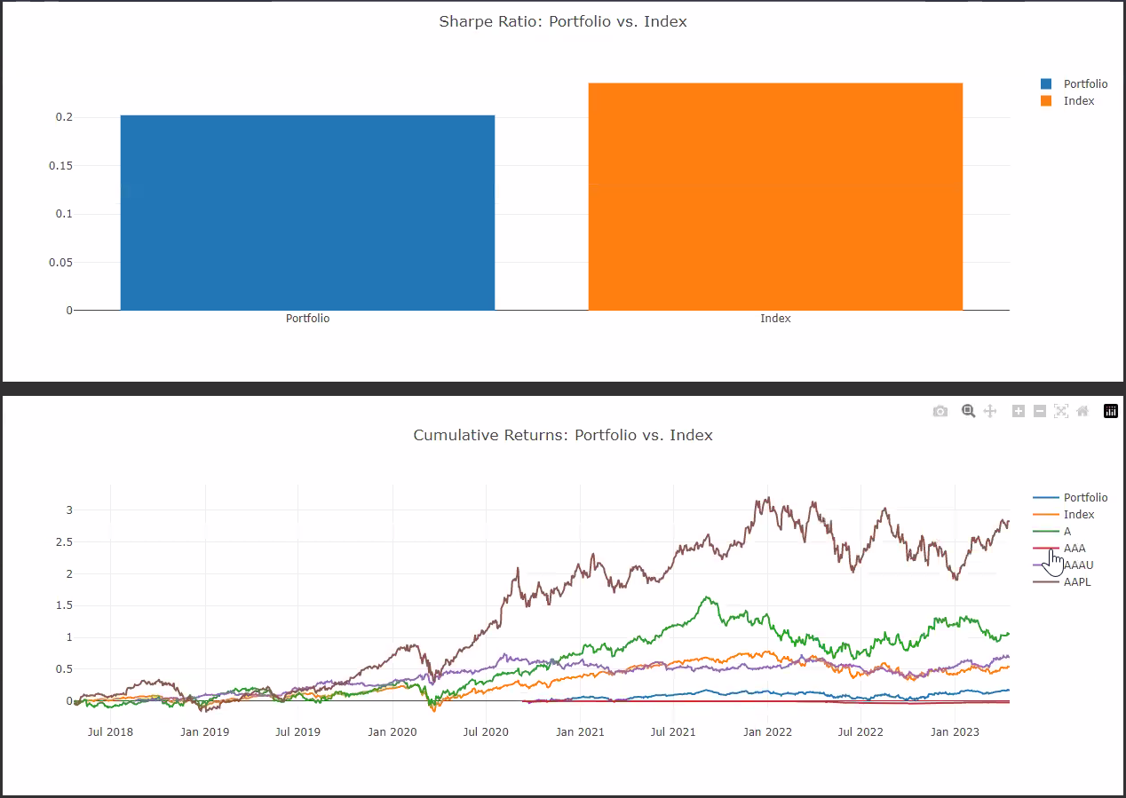
In what ways can an investor visualize their investment planning data?

Slide 8
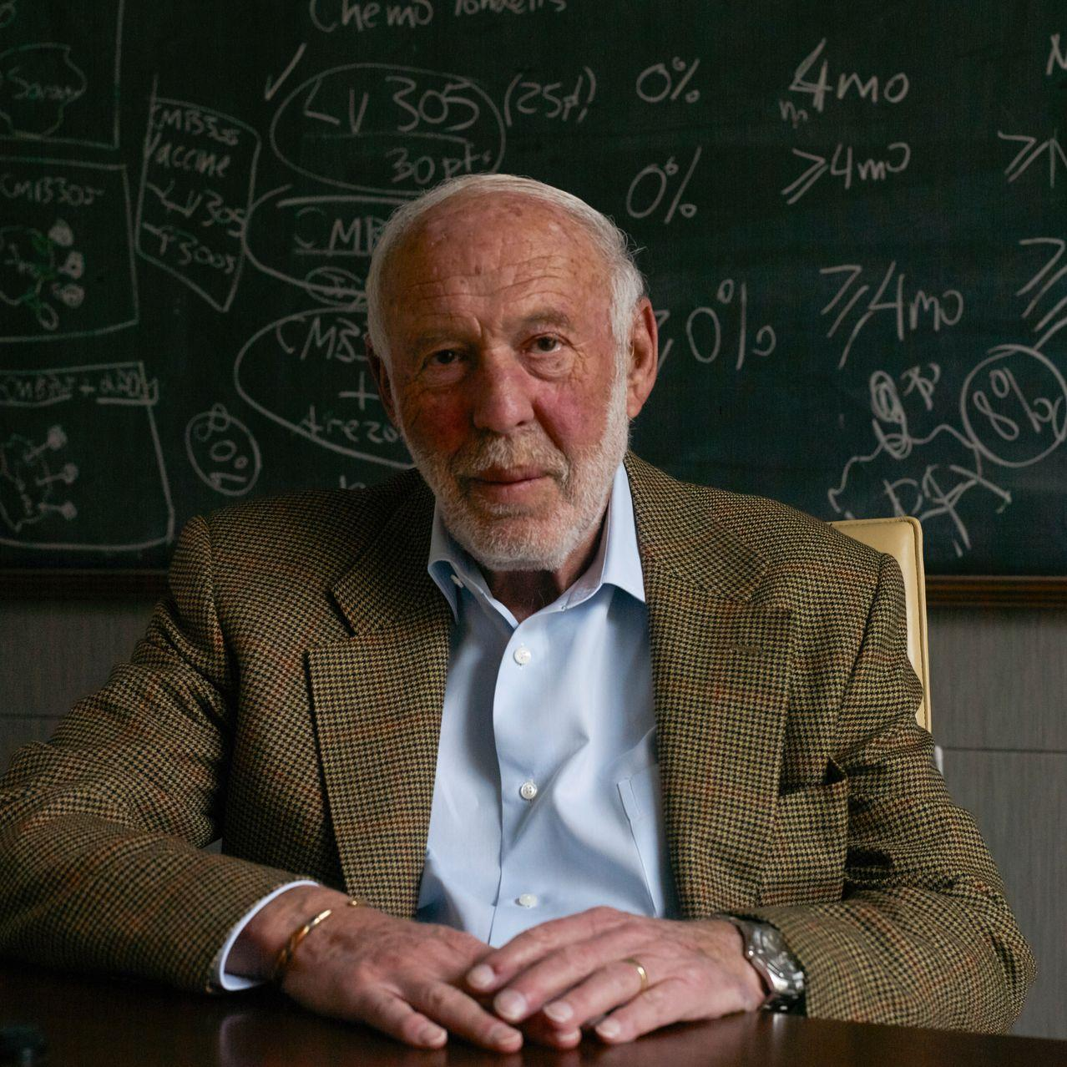
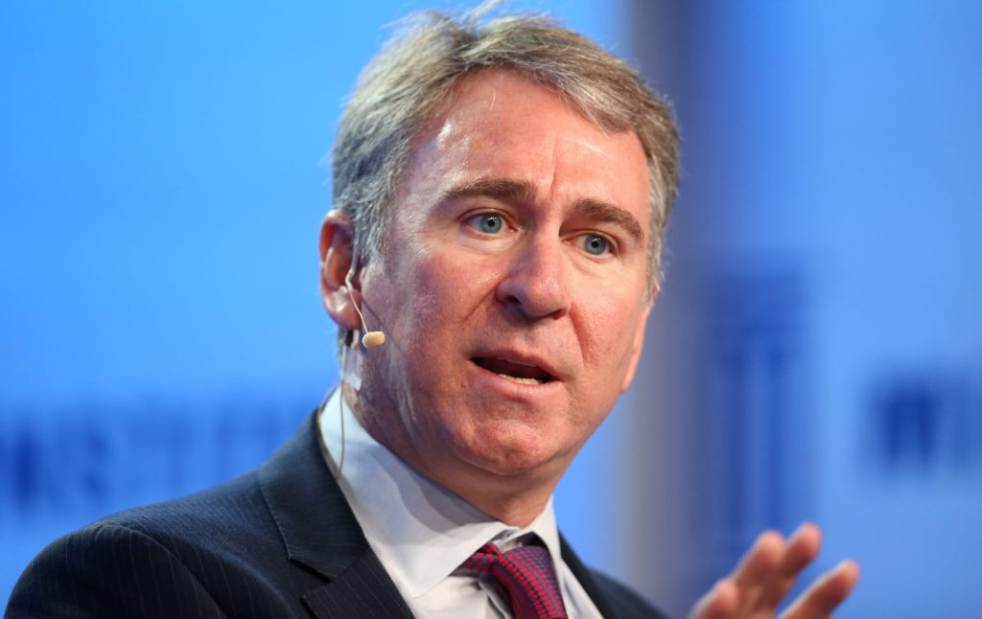
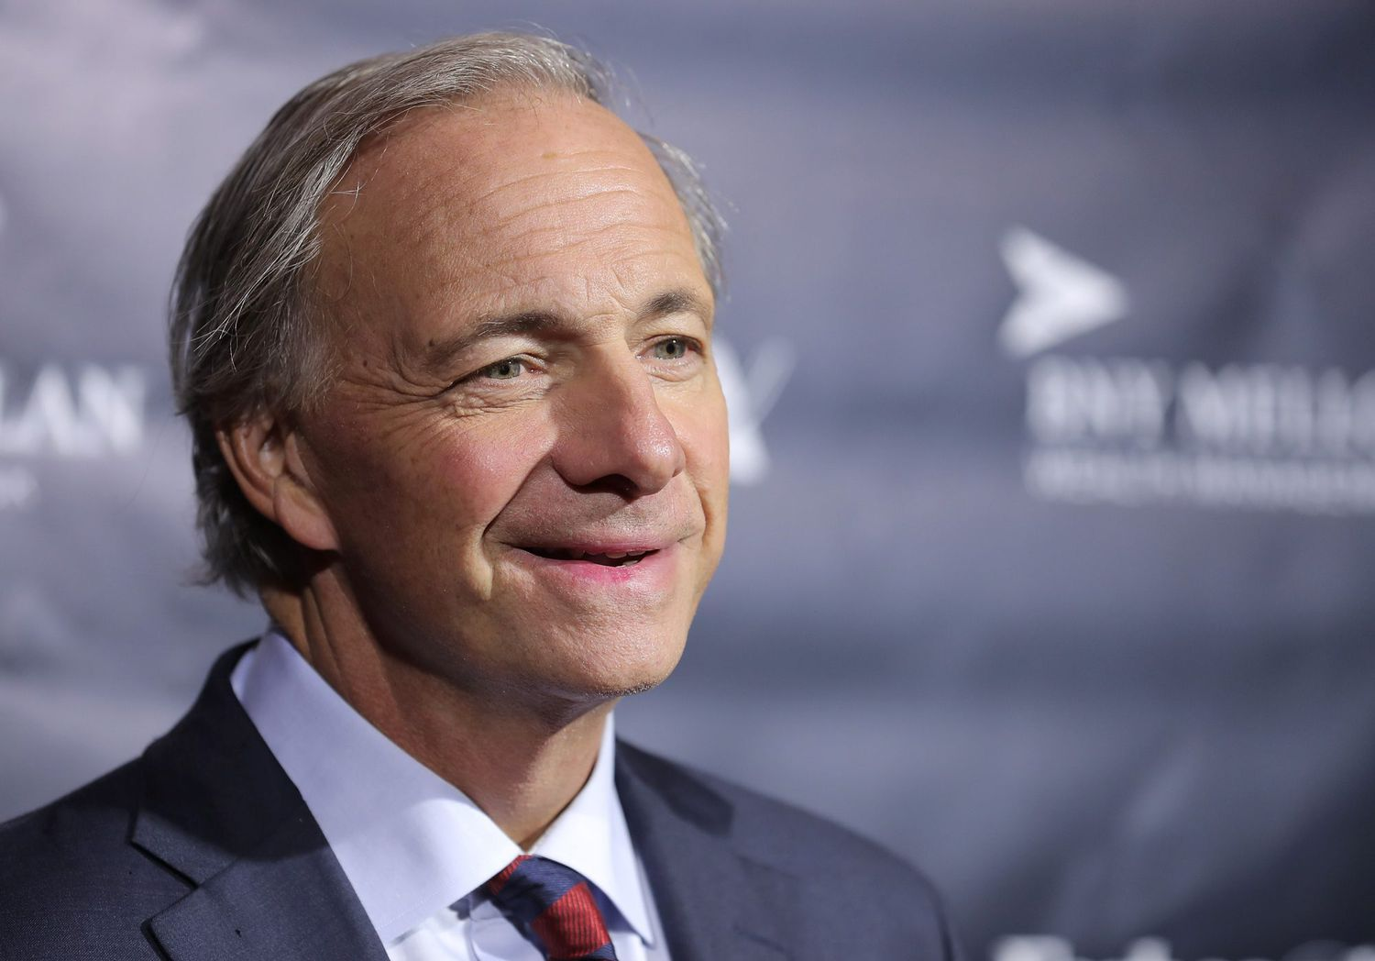
Who can use this application?
Warren Buffet
Jim Simons
Ken Griffin
Ray Dalio

Slide 9




Who else can use this application?
Julian Ritchey
John Yin
Andrea Delgadillo Tomasevich
Dmitry Chalganov

Slide 10
Let’s Use the Application
https://fintech1.richedev.com

Slide 11
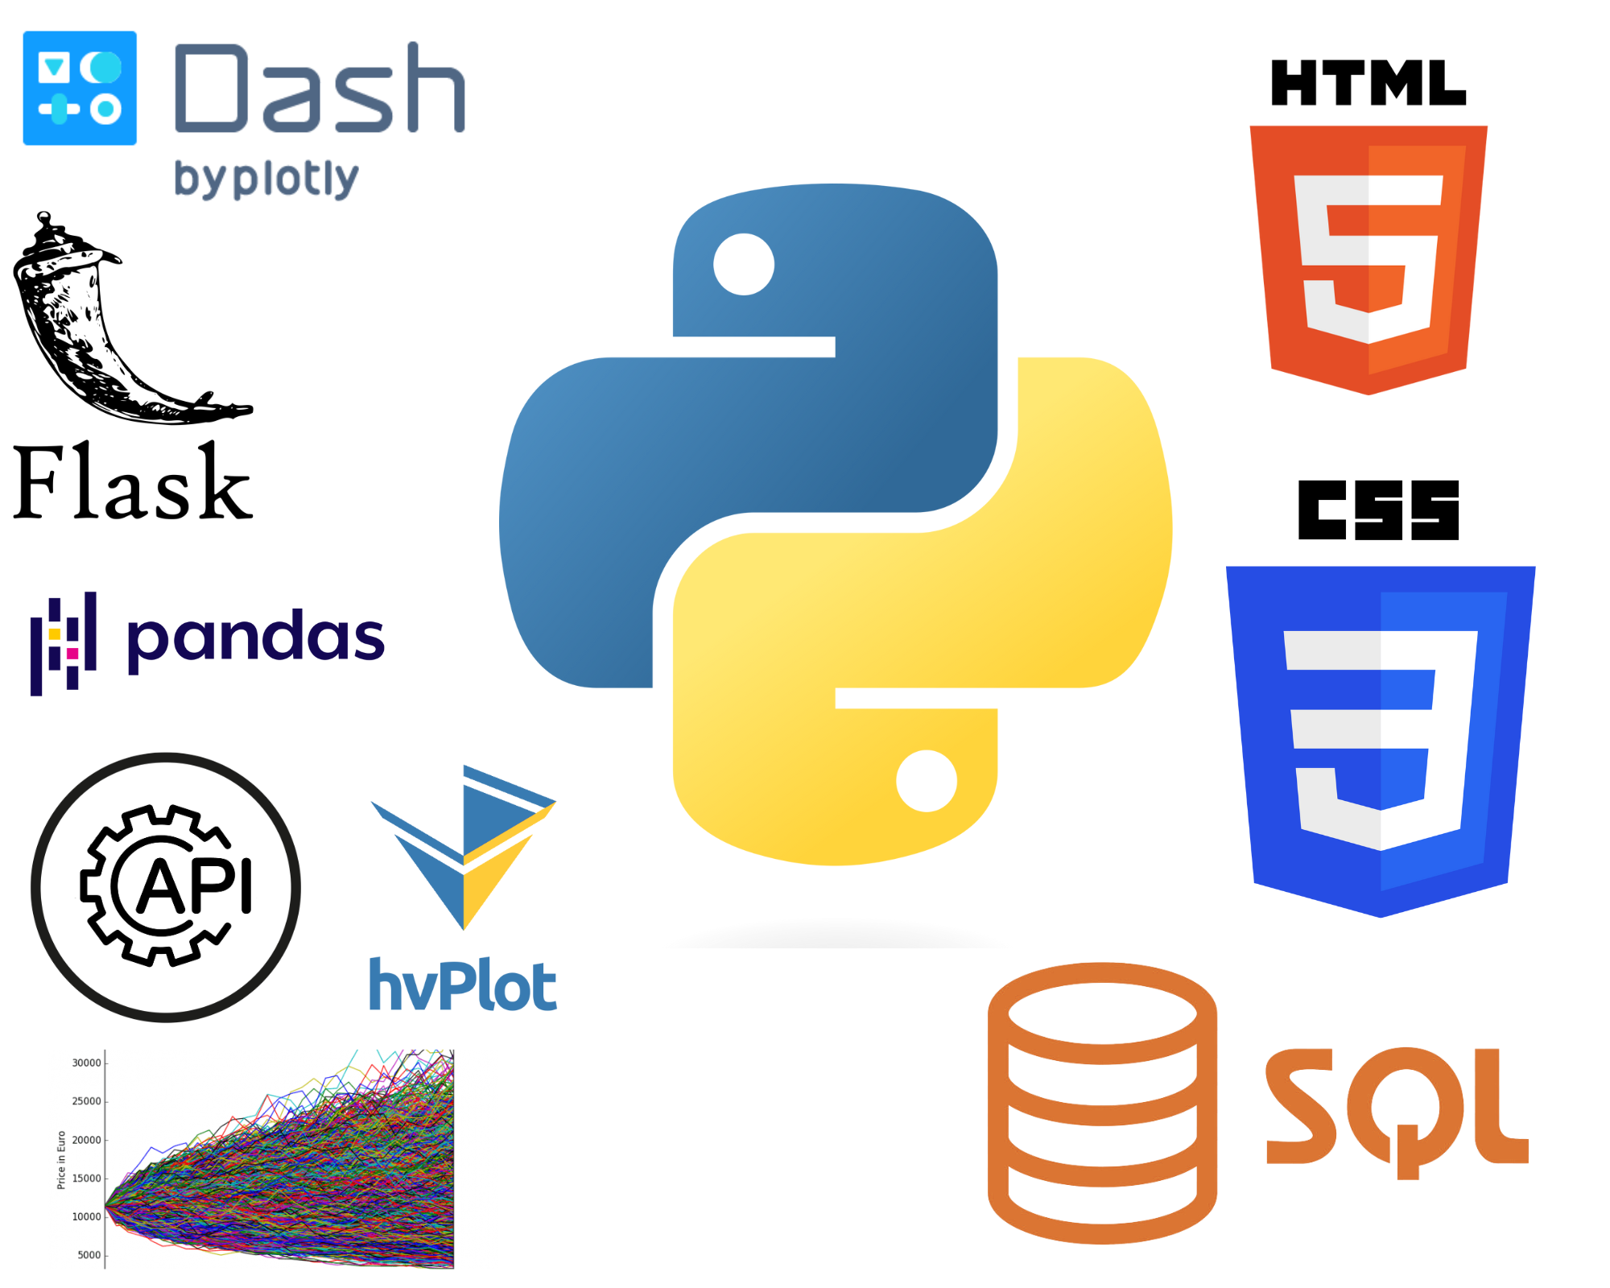
What Technology was used?
Python (main programming language)
Flask
Dash
API Calls
pandas
Monte Carlo Simulation
hvPlot/Pyfolio
SQL
HTML
CSS

Slide 12
Data Resources Cleaning and exploration
APIS:
Historical Data:
Yahoo Finance API
Alpaca API
Current Investments
Kucoin crypto exchange API
Coin API
Alpha Vantage API
Data Cleaning:
Pandas
Set data hierarchy according to the requirements
Deleting, renaming columns
Easier to clean data using one constant source, e.g. yfinance library
Concatenating different Dataframes
Data Cleaning Issues:
Monte Carlo Simulation required multi-index function instead of single-layer structure provided by Yahoo Finance, so code was written to restructure Yahoo Finance data.
Data was hardcoded at first for testing purposes and then code was rewritten with variables only
Function names have been changed for the SQLAlchemy 2.0.9, so we reverted to 1.4.47 version

Slide 13
Project Difficulties
Learning Flask from scratch
Learning Dash from scratch
Investigating API interactions of various servers
Integrating separate developer code
Integrating Auth0 user login manager
Connection to the databases

Slide 14

Thank You for Attention!

